Slide 1
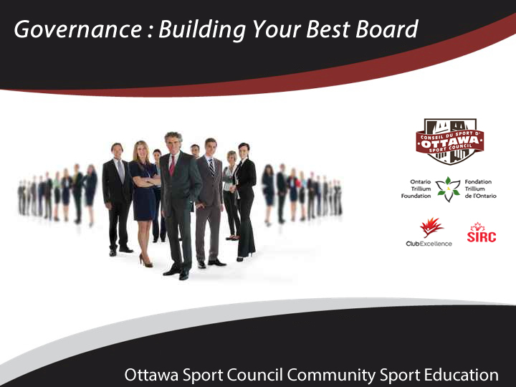

Slide 2
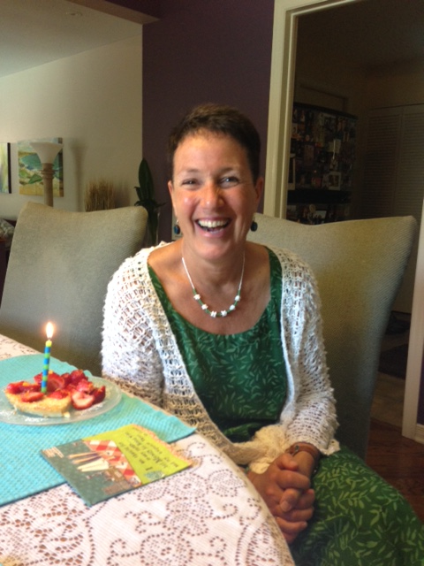
Ottawa Sport Council
Non-profit membership based service organization established in response to demand for assistance from community sporting organizations
Marcia Morris
ED, Ottawa Sport Council
What do we Do?
  Advocacy and Marketing
  Educational Programs- webinars, Sport Summit
  Ottawa Sport Council Foundation- endowment fund to support community sport organizations

Slide 3

Ottawa Sport Council Community
Sport Education
2015- 8 educational overview webinars including legal issues, event management, nutrition, sponsorship, Twitter, governance, volunteers
Feedback
  requirement for more comprehensive education - accessible, on-demand format.
  Education regarding sport management topics - social media marketing, governance, volunteer management.
Deliverable
  development of comprehensive on-line modules
  courses developed to help community sport organizations to understand ‘Club Excellence’ standards - the only national multi-sport certification program for club level sport organizations (www.clubexcellence.com)
  Courses – delivered in segments, available on demand
Thanks to Ontario Trillium Foundation

Slide 4

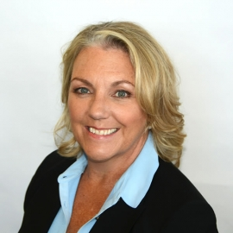
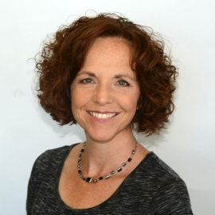
Today’s Speakers
Debra Gassewitz
Chief Executive Officer
Sport Information Resource Centre (SIRC)
debrag@sirc.ca
sirc.ca
Margo Crawford
President & CEO
Business Sherpa Group
margo@businesssherpagroup.com
businesssherpagroup.com
Jan O’Donnell
Independent Virtual CFO & Practice Lead
Business Sherpa Group
jan@businesssherpagroup.com
businesssherpagroup.com
Notes:
No speaker from CE

Slide 5
Segment 1 of 5

Slide 6
What will you learn within the 5 segments of the
Sport Governance Learning Module?
5 Things You Should Know to Build your Best Board
What is the difference between governance and operations?
Who should you have on your Board?
How do you recruit them?
What do they need to know before they apply?
How do you maximize Board contributions?

Slide 7
This first segment will cover the basics:
What is Governance
Governance vs Operations
Who cares?
Board composition
Board recruitment
Terms of Reference and Policies
Feedback and moving forward
The next segment will cover :

Slide 8
Governance
Helps you understand the Club Excellence Standards relating to governance which include:
Creating a governing mission statement and values with procedures for review/revision
Demonstrating appropriate board structure & procedures
Established policies and procedures relevant to nominations & elections
Provision of relevant documentation and resources

Slide 9
What is Governance?
The system by which organizations are directed and managed:
Directed: vision, mission, values, strategic plan
Managed: roles and responsibilities, financial controls, human resources, outcomes and results

Slide 10
What is governance? Cont.
How an organization is run by the Board:
Board strategically directs and leads an organization
Board defines expectations, delegates authority and adheres to legal requirements
Board realizes organizational goals …while aligning to values and social norms

Slide 11
What is governance in Sport?
Product is our people – athletes
Melds passion and dedication of volunteers
Board and Operations together form a focused governance team, operating with integrity and striving to enhance the performance and reputation of the sport, as well as the experiences of the participants.

Slide 12
Governance and Operations

Slide 13

Governance Principles
Commitment to Vision, Mission, Values and Guided by a Strategic Plan
Transparent and Accountable for Outcomes and Results
Clarity of Roles and Responsibilities
High Standards of Ethical Behaviour
Focused on Human Resources
Effective Financial Control

Slide 14
Boards
create the strategic plan (vision, mission, values, objectives, key performance indicators)
define the roles and responsibilities and authority of Board and Sr management
Operations
use the vision, mission, values to implement the strategic plan
implement the roles and responsibilities as defined by the Board
define roles and responsibilities of individuals reporting to senior management

Slide 15
Boards
develop and approve policies
approve and monitor the budget
align financial plan to strategic plan
ensure compliance with legislative obligations
Operations
Draft, recommend and implement policies for Board approval
create the budget
monitor financial status on a frequent basis
comply with legislation

Slide 16
Boards
orient, develop, plan for succession
evaluate, reward and recognize Board members, Board Committee volunteers and senior management
Operations
orient, develop, plan for succession
evaluate, reward and recognize staff and Program volunteers

Slide 17
Why is this important?
NFP and ONFP put a focus on governance
  Who on Board
  How long are their terms
  Roles and avoidance of conflict
Funders looking at sport organization governance

Slide 18
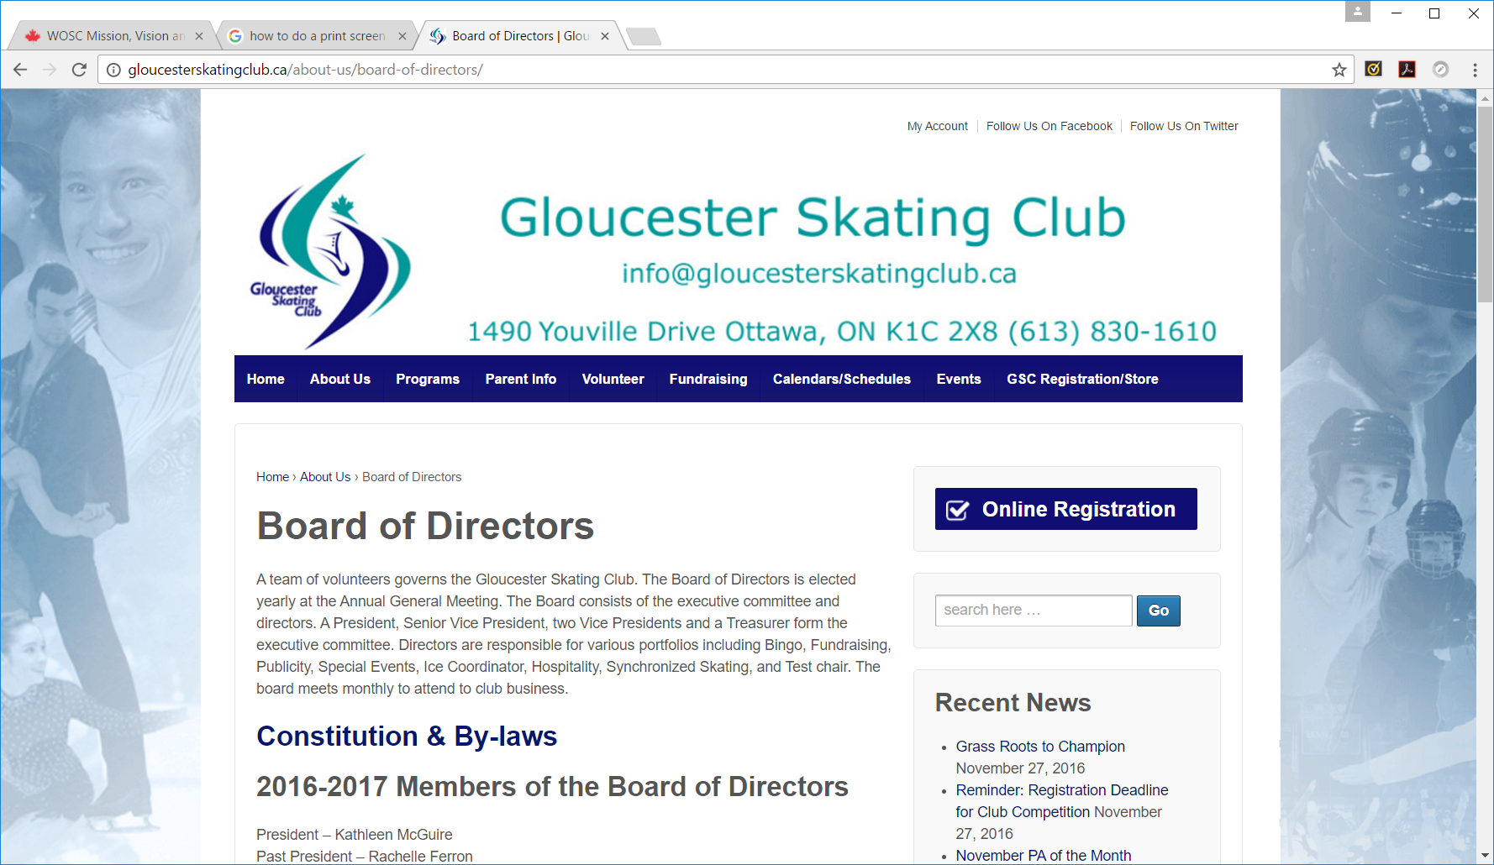

Slide 19
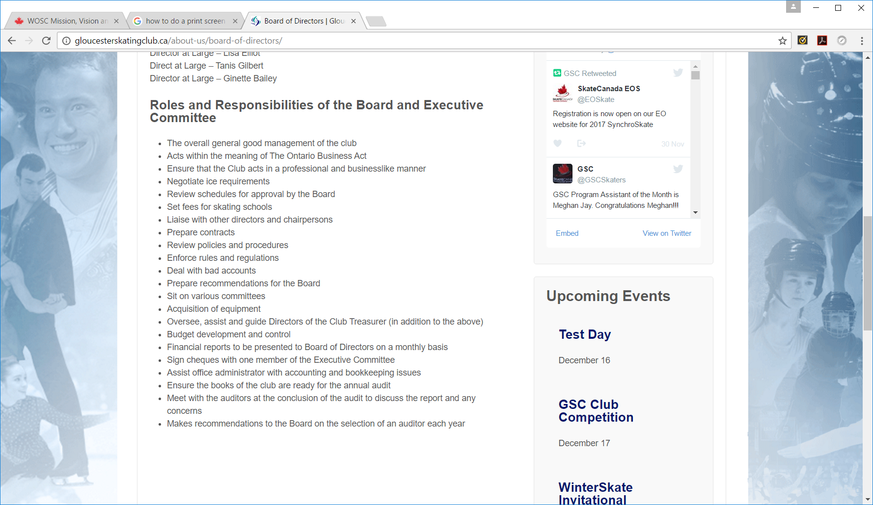

Slide 20
How do you tell people what you are about?
Vision: A vision statement sets out the long-term desired state of the organization. It is a powerful and bold statement of your preferred future.
Mission: Your mission statement clearly articulates what you do for constituents. It provides a connecting force to remind stakeholders what you stand for
Values: Values are statements of conviction that express what an organization most believes in.
Resources
Writing a Mission Statement
Example Mission & Values of the Club
Mission & Vision Template

Slide 21
Sample Club Excellence Mission statement check list
Does it begin with a verb?
Is it clear and simple?
Does it describe for “what”, “for whom”, “how”
Is it realistic?
Does it describe the uniqueness of the organization?
Does it embrace all members of the organization?
Does it provide options for growth and development?

Slide 22
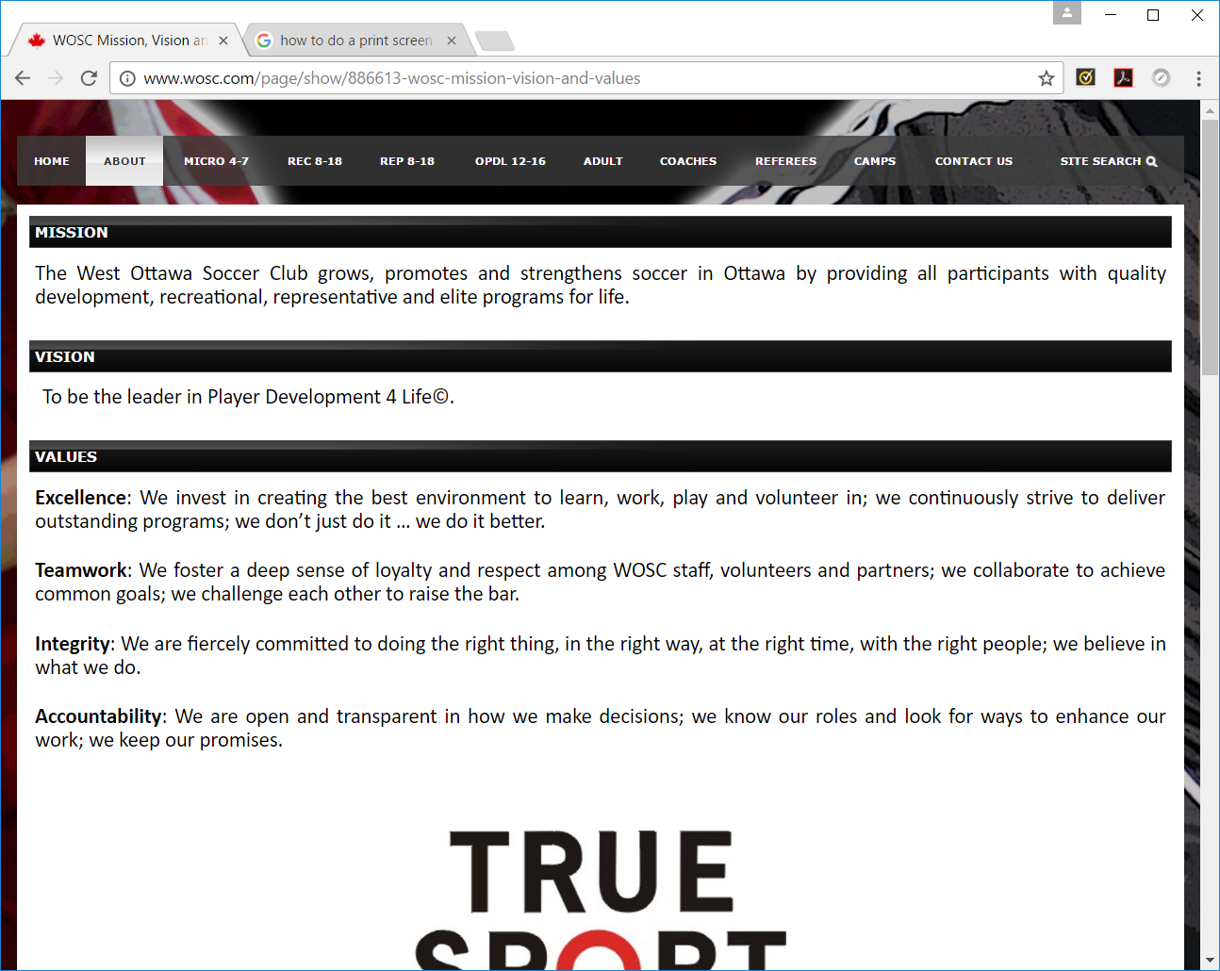

Slide 23
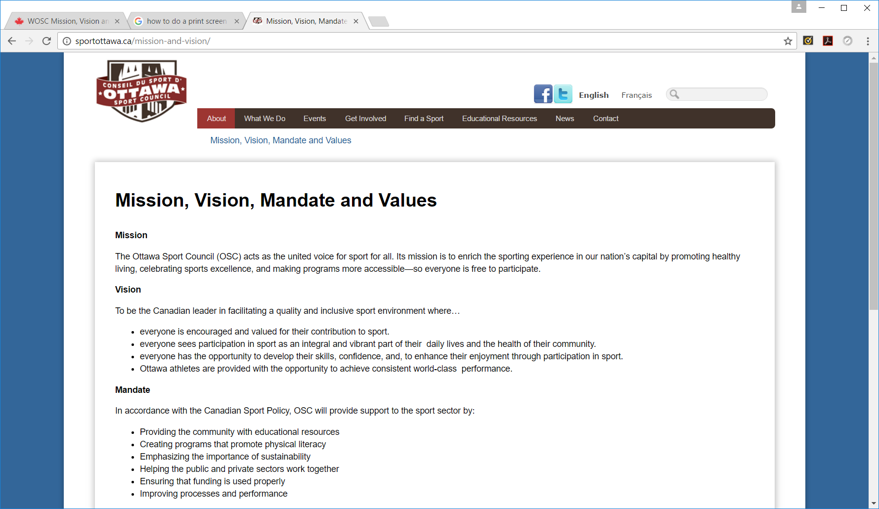

Slide 24

Thank You
This concludes Segment 1 of Governance: Building Your Best Board, continue learning by watching:
Segment 2 on Board composition
Segment 3 on Board recruitment
Segment 4 onTerms of Reference and Policies
Segment 5 on Feedback and moving forward

Slide 25
Segment 2 of 5

Slide 26

Board Composition
Who should you have on your Board?

Slide 27
Reflecting on the role of the Board
Stewardship
Standard of care
  Fiduciary duty (act honestly and in good faith in best interests of the organization)
  Duty of care (exercise care and diligence)
  Business judgement (diligent decision-making process in best interests of the organization)

Slide 28
Unique elements of your organization to consider
Current operations and plans for the future
Any complexities of your funding sources and/or operations
Risk profile (is funding secured? is sport higher risk?)
What are the keys to your success as an organization?
Is your board built to support these elements?

Slide 29
What skills do you need?
  Board experience
  Finance
  Legal
  Industry knowledge
  Governance
  Grant writing / Fundraising
  Marketing and/or Communications
  Sport
  Government Relations
  Media
  Revenue Generation
  Risk Management
  Strategic Planning
  Technology
Resource
Example Board Skills Matrix

Slide 30
How Operational is your Board?
  Do you have staff resources? Volunteer resources?
  Is there a CEO in place?
  Is the board managing or operationally running the organization?
Administrative /
Management Boards
Policy and
Policy Governance Board
Governance
Management
Operations

Slide 31
What perspectives will help?
Diversity and inclusivity
  Gender
  Geographic region
  Under-represented groups
  Age
  Sport Level

Slide 32
How many will be optimum?
  Small: no less than 3
  Medium: 5-7
  Large: 8+
Resource
Board responsibilities
Good governance for not-for-profit (NFP) organizations: Questions for directors

Slide 33
What are the different roles within the Board?
Roles are often outlined in your club bylaws.
Board member
President
Vice President
Treasurer
Secretary
Committee (Volunteer Coordinator, Fundraising, etc.)
Staff (reporting/non-voting)

Slide 34
Skills Matrix
Skill | Importance Weighting (rank 1-5 or colour code) | Board Member #1 | Board Member #2 | Board Member #3 | Recruiting Priorities
Communications/Marketing
Demographics - relevant (ie age)
Finance/Accounting
Fundraising/Grants
Geographic/Membership representation
Governance experience
HR/Compensation
Risk Management/Legal
Sport - Competition, Coaching, Programs
Volunteers
Resource
Example Board Skills Matrix

Slide 35
Thank You
This concludes Segment 2 of Governance: Building Your Best Board, continue learning by watching:
Segment 1 on What is Governance and Governance vs Operations
Segment 3 on Board recruitment
Segment 4 onTerms of Reference and Policies
Segment 5 on Feedback and moving forward

Slide 36
Segment 3 of 5

Slide 37
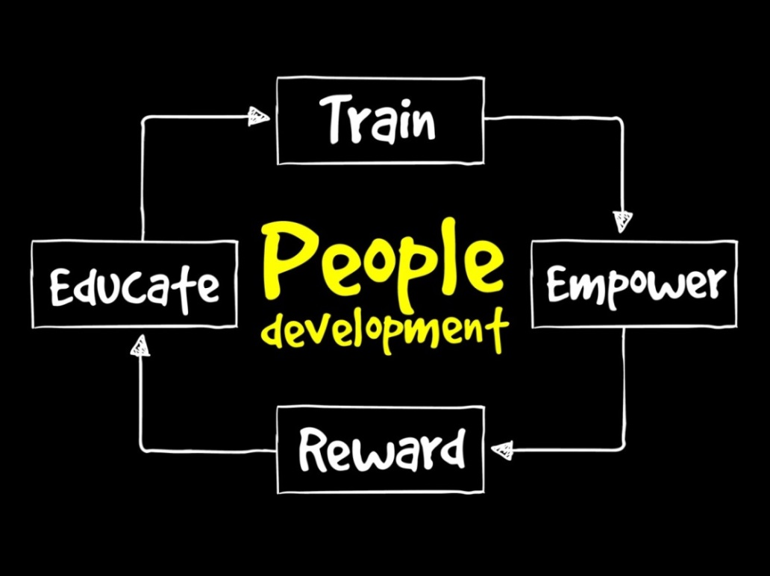
Board Recruitment
How do you recruit the best Board members?

Slide 38
What is the process?
Planning
Timing
Recruiting
Evaluating Fit
Nominations
Elections
Resources
Sample Board Selection Process

Slide 39
What goes in the recruitment description?
Position type
General Organization description
Duties & Responsibilities
Orientation & Training
Term length
Experience/Skills required
Additional knowledge areas
Evaluation
Resources
Example Board Member Job Description
Board Job Description Template

Slide 40
Where do you look for possible Board
Members?
Stakeholders
Partners
Skills Required
Membership

Slide 41
Thank You
This concludes Segment 3 of Governance: Building Your Best Board, continue learning by watching:
Segment 1 on What is Governance and Governance vs Operations
Segment 2 on Board composition
Segment 4 onTerms of Reference and Policies
Segment 5 on Feedback and moving forward

Slide 42
Segment 4 of 5

Slide 43

Terms of Reference
What do they need to know before they apply?

Slide 44
How do we operate effectively as a Board?
Terms of Reference
Role expectations
Work plans
Meetings & Minutes
Policies
Resource
Sample Board Mandate
Sample Board Workplan Template

Slide 45
How long is the possible commitment?
Length of Term
# of meetings
Time requirements
Resources
Terms of Reference Template
Sample Terms of Reference – Audit Finance
Committee

Slide 46
What are the Board members expected
to do?
Attend meetings regularly
Pre-meeting preparation
Actively participate / Show commitment
Request clarification or more information as needed
Avoid any potential conflicts of interest
Understand and maintain confidentiality
Committee involvement
Financial requirements
Ensure legal and regulatory compliance

Slide 47
What do good Minutes and Motions look like?
Minutes:
The date and location of the meeting
Members who were present for voting
Motions put forth, the mover and seconder
Amendments to motions
The outcome of the motion (whether it was carried or not) and record of the vote (dissenters, who voted in abstention or by proxy)
Motions:
Specific, unique, concise
Address potential objections
Resources
Template – Meeting Agenda & Minutes
Sample Board Agenda
A Guide to Great Board Minutes
How to Write a Motion for a Board Meeting

Slide 48
What policies should you have in place?
Board (or equivalent) approved/adopted and regularly reviewed polices
and documentation:
Code of ethics/conduct for all directors, staff, coaches and volunteers
Conflict of interest policy for Board, staff, coaches, officials and volunteers
Harassment and abuse policy for the board of directors, volunteers, staff, officials, coaches, athletes, parents and members/participants
Communication and privacy policy
Conflict resolution policy and a process through which decisions can be reviewed or appealed to a higher governing body
The club is registered as a society under a provincial society act or is incorporated at the provincial or federal level (either not-for-profit or for-profit)
A constitution, by-laws and/or operational policies and procedures.
Certificate of insurance in the club’s name for all members, programs, and activities
Resources: Templates and Example Policies
Notes:
Please reference standard #

Slide 49
Thank You
This concludes Segment 4 of Governance: Building Your Best Board, continue learning by watching:
Segment 1 on What is Governance and Governance vs Operations
Segment 2 on Board composition
Segment 3 on Board recruitment
Segment 5 on Feedback and moving forward

Slide 50
Segment 5 of 5

Slide 51
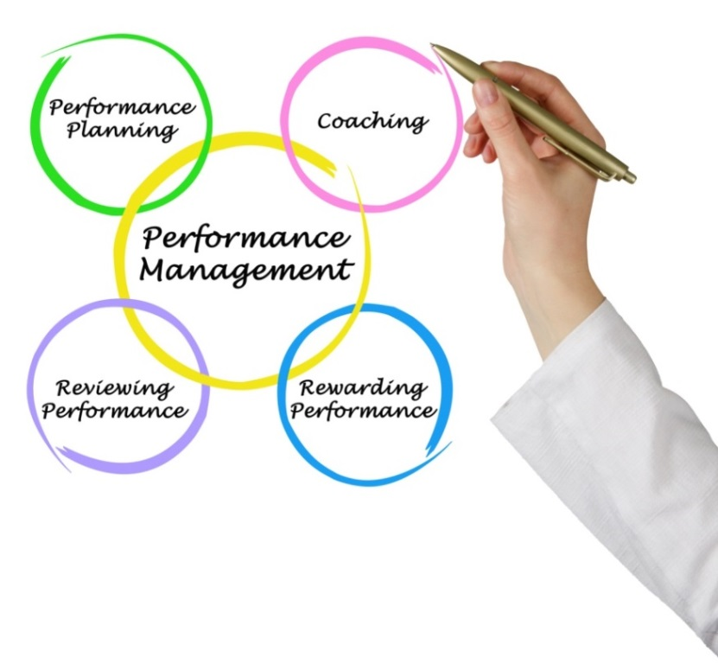
Feedback/Evaluation
How do we maximize Board
contributions?

Slide 52
When and how to provide feedback?
Board self-evaluation
Board evaluation
[Senior staff evaluation]
Resources
Sample Board Self-Evaluation Questionnaire
Template – Coach Performance Evaluation

Slide 53
How did the Board help?
What did we learn?
How can we improve?

Slide 54
How to recognize volunteer Board contributions?
Public recognition
Personal thanks
Corporate swag

Slide 55

Succession Planning
How do you ensure smooth Board member transitions?

Slide 56
How do you develop a successful Board Succession Plan?
Planned succession
Unplanned succession
Resources
Webinar – Succession Planning
Sample Emergency Succession Planning Template
Notes:
Standard # 14 and 29

Slide 57




Get in touch
Marcia Morris
Executive Director
Ottawa Sport Council
marci@sportottawa.ca
sportottawa.ca
Debra Gassewitz
Chief Executive Officer
SIRC
debrag@sirc.ca
sirc.ca
Margo Crawford
President & CEO
Business Sherpa Group
margo@businesssherpagroup.com
businesssherpagroup.com
Jan O’Donnell
Independent Virtual CFO & Practice Lead
Business Sherpa Group
jan@businesssherpagroup.com
businesssherpagroup.com
Amanda Burford
Club Excellence
aburford@cces.ca
clubexcellence.com

Slide 58
Resources
Writing a Mission Statement
Example Mission & Values of the Club
Mission & Vision Template
Example Board Skills Matrix
Sample Board Selection Process
Example Board Member Job Description
Board Job Description Template
Sample Board Mandate
Sample Board Workplan Template
Terms of Reference Template
Sample Terms of Reference – Audit
Committee
Template – Meeting Agenda & Minutes
Sample Board Agenda
A Guide to Great Board Minutes
How to Write a Motion for a Board Meeting
Templates and Example Policies
Sample Board Self-Evaluation Questionnaire
Coach Performance Evaluation Template
Webinar - Succession Planning
Sample Emergency Succession Planning Template
Club Excellence

Slide 59

Thank You
This concludes the Governance: Building Your Best Board module, continue learning by watching the other modules in this series:
Volunteer Management: Standards, Good Practices & Practical Solutions
How to Facebook

Slide 60


