Slide 1
How to Facebook
Optimizing Your Business Page

Slide 2
Ottawa Sport Council
Non-profit membership based service organization established in response to demand for assistance from community sporting organizations
Marcia Morris
ED, Ottawa Sport Council
What do we Do?
Advocacy and Marketing
Educational Programs- webinars, Sport Summit
Ottawa Sport Council Foundation- endowment fund to support community sport organizations

Slide 3
Ottawa Sport Council Community Sport Education
2015- 8 educational overview webinars including legal issues, event management, nutrition, sponsorship, Twitter, governance, volunteers
Feedback
requirement for more comprehensive education - accessible, on-demand format.
Education regarding sport management topics - social media marketing, governance, volunteer management.
Deliverable
development of comprehensive on-line modules
courses developed to help community sport organizations to understand ‘Club Excellence’ standards - the only national multi-sport certification program for club level sport organizations (www.clubexcellence.com)
Courses – delivered in segments, available on demand
Thanks to Ontario Trillium Foundation

Slide 4
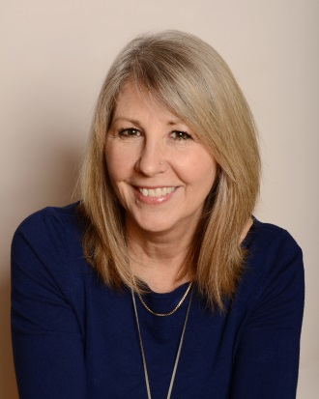
Today’s Speaker
Kim Barr
Proprietor
Set The Barr – Meaningful Marketing
Kim’s email
setthebarr.com
Notes:
No speaker from CE

Slide 5
How to Facebook
Segment 1 of 3
Optimizing Your Business Page

Slide 6
Why Facebook?
We have chosen to concentrate on Facebook as it is unquestionably the largest social network in the world with over 1.5 billion monthly users and over a billion daily active users. The average user spends nearly one hour per day, per user. According to DMR Stats, Canada is the #1 country that uses Facebook.

Slide 7
What this Segment Covers
Basic page set up
How to optimize your “About” section
How to invite friends to like your page
Events and Milestones

Slide 8
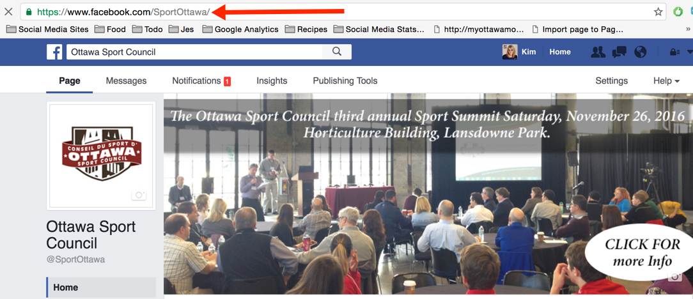
Claiming your URL

Slide 9
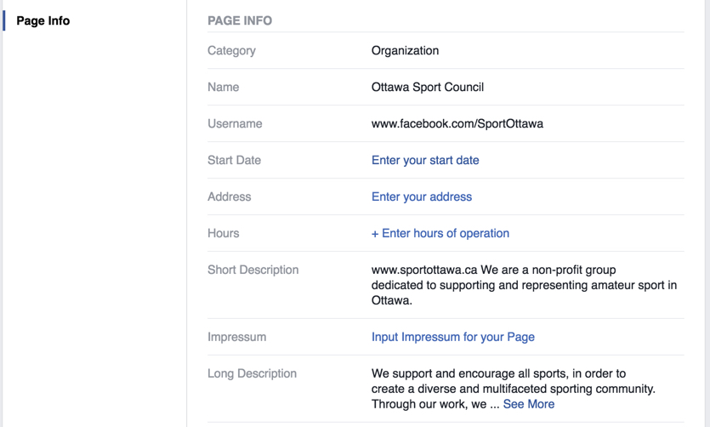
Notes:
Make sure it is keyword rich. Searches in Google pull from here.

Slide 10
Edit! You only get one chance to change it

Slide 11
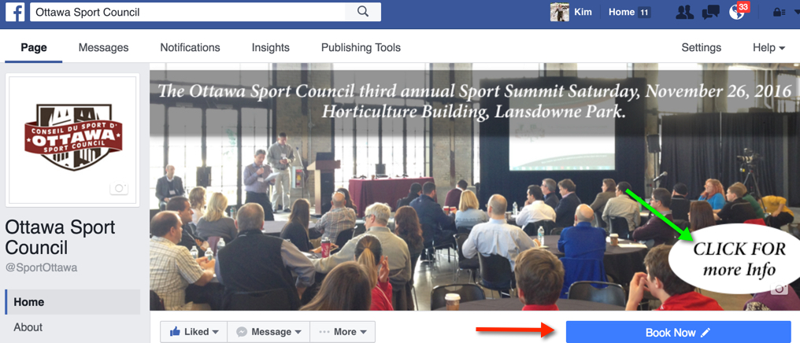
Change Your Cover Photo

Slide 12
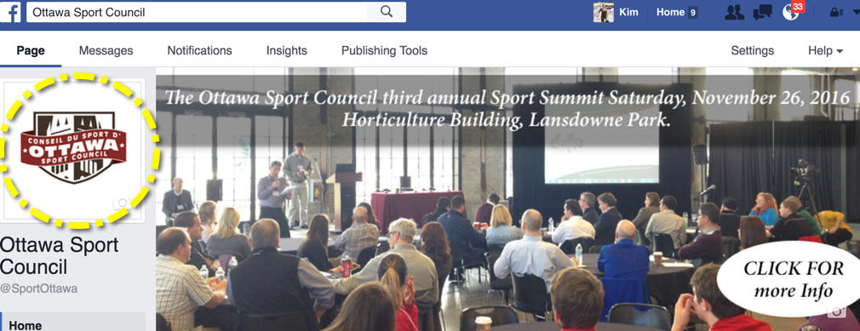
Profile Picture

Slide 13
You can have a click on the cover photo, then you can edit and add info.
Great for registrations / sign ups
Announcements
Tournaments
Offers, Etc.
Be sure to have a Call To Action Button. You can have a different URL driving them somewhere else as well… example if you have a registration / Sign up form
Little trick: tag yourself on the picture so you get double duty on exposure.

Slide 14
Make sure the cover image is sized properly.
Here is a great link: https://www.facebook.com/PagesSizesDimensions
Canva gives you the proper template 828 x 315.
Profile picture 180 x 180.
https://www.canva.com/
Pic Monkey or Photoshop

Slide 15
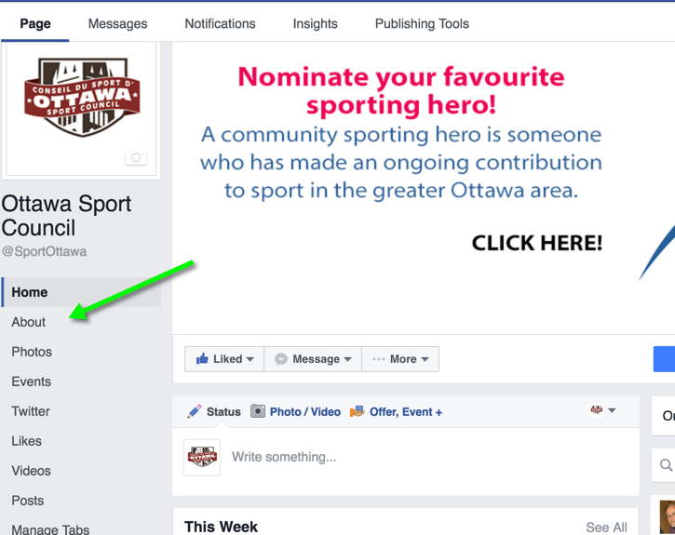
Completing Your About Section

Slide 16
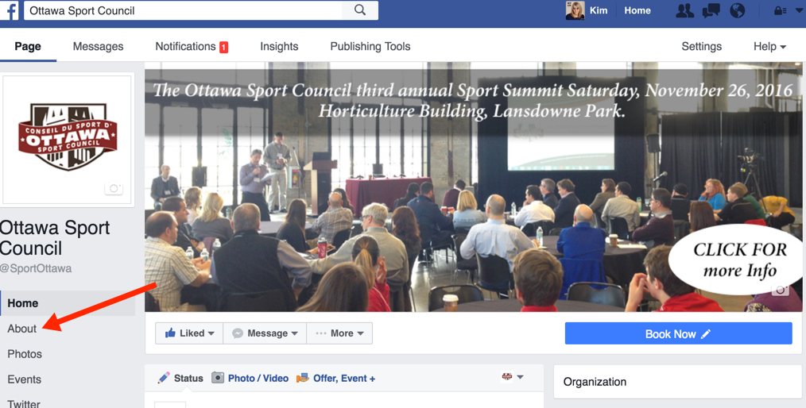
Under ”About”

Slide 17
Notes:
Make sure it is keyword rich. Searches in Google pull from here.

Slide 18
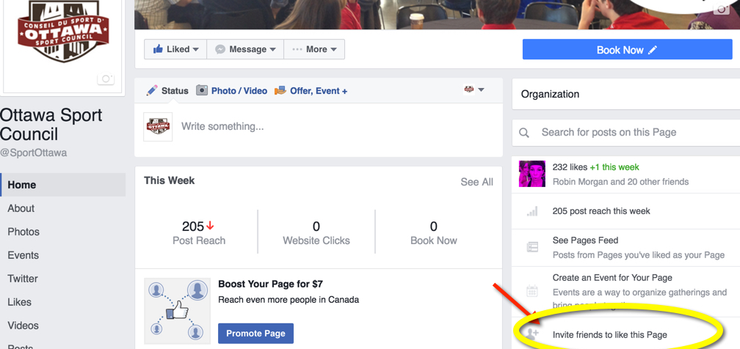
Invite Friends

Slide 19
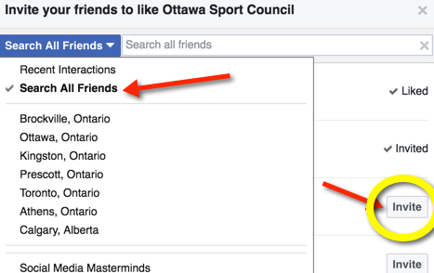

Slide 20
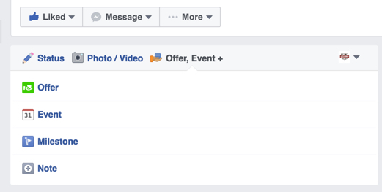
Offers, Events and Milestones

Slide 21
Thank You
This concludes Segment 1 of How to Facebook, continue learning by watching:
Segment 2 on Understanding Insights and Boosting
Segment 3 on Photos and Videos

Slide 22
How to Facebook
Segment 2 of 3
Optimizing Your Business Page

Slide 23
What this Segment Covers
Understanding settings and insights
Boosting a post

Slide 24
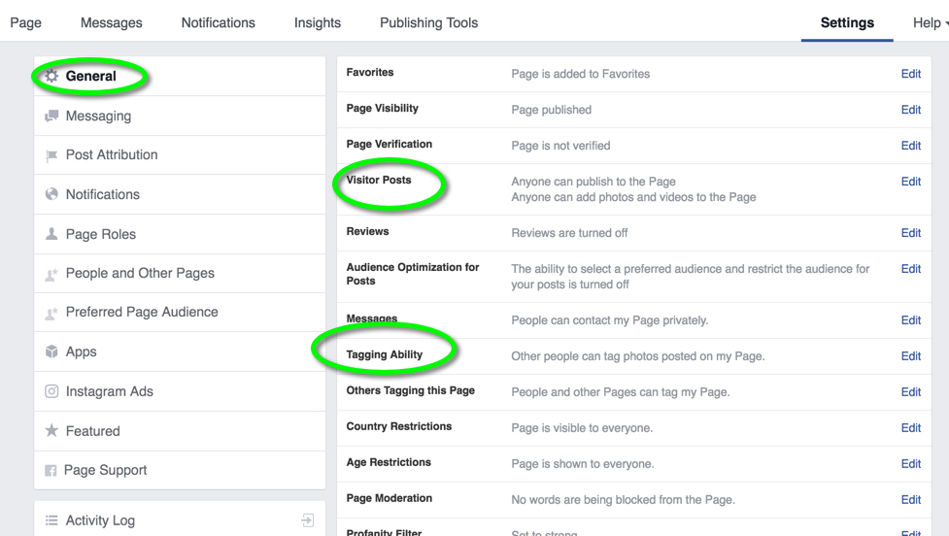
Settings

Slide 25
Insights

Slide 26
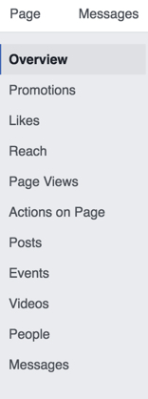

Slide 27
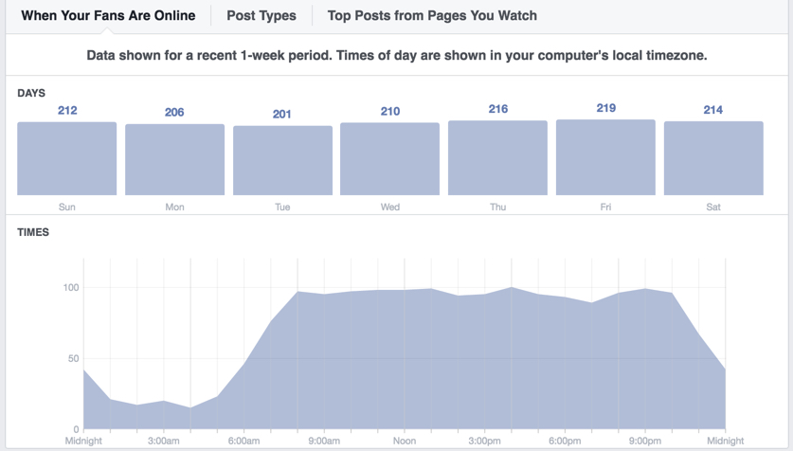

Slide 28
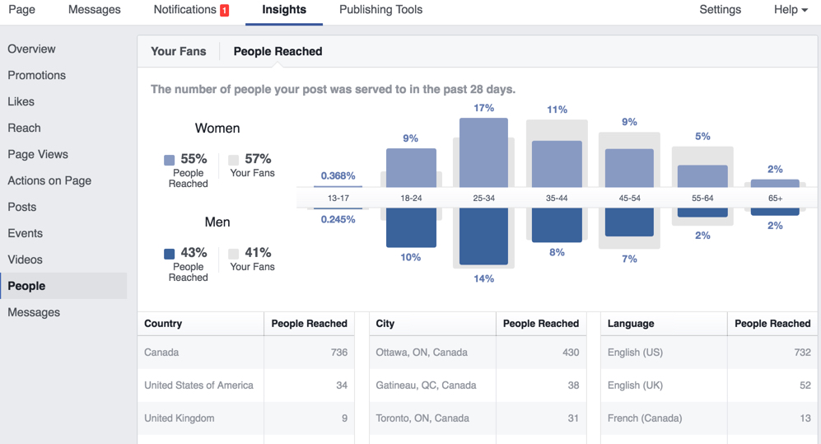

Slide 29
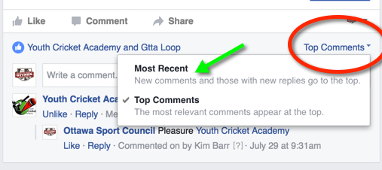
Most recent comment

Slide 30
Tips and Resources
Make sure on your personal profile, your place of work is linked to your page.
Scheduling posts
Pages App - easier access to you page via mobile
Cool Apps: Legend, PhotoGrid, Word Swag, Rookie Cam, Lumyer
Resources: www.socialmediaexaminar.com, www.setthebarr.com, www.AmyPorterfield.com, Hootsuite.com

Slide 31
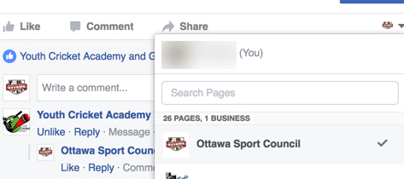
Increasing your exposure
Sharing your post on your personal profile
Sharing a post on your personal profile that has selected audience

Slide 32
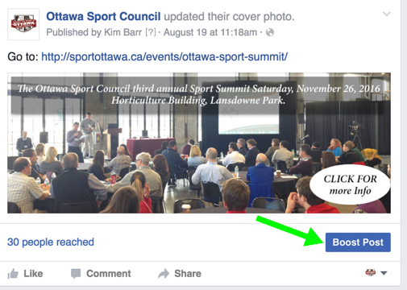
Boosting Your Post

Slide 33
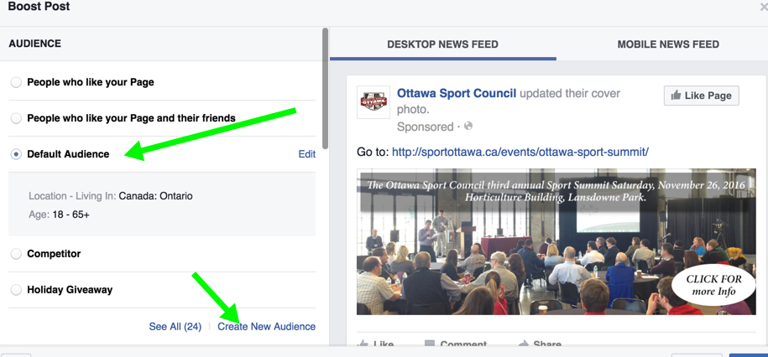

Slide 34
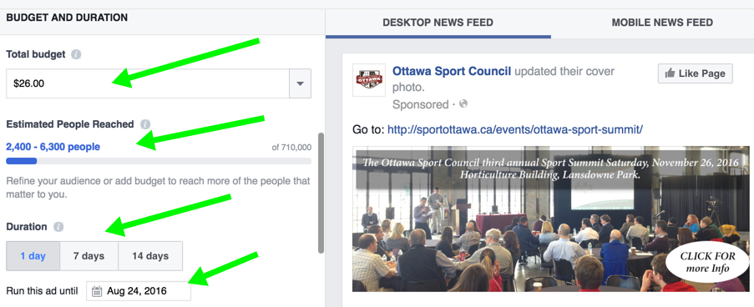

Slide 35
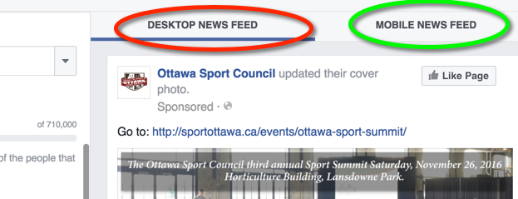

Slide 36
Thank You
This concludes Segment 2 of How to Facebook, continue learning by watching:
Segment 3 on Photos and Videos
Segment 1 on Basic page set up, How to optimize your “About” section, How to invite friends to like your page, Events and Milestones

Slide 37
How to Facebook
Segment 3 of 3
Optimizing Your Business Page

Slide 38
What this Segment Covers
What is live video and how to use it
The different types of photo upload

Slide 39
Videos
Keep it organic
Try not to share from YouTube
Customize your Landing page with call to action

Slide 40
Live Facebook vs Uploaded Video
Live = better reach
Live = longer video
Upload = short (60 sec)
Upload = edit
upload = select audience

Slide 41
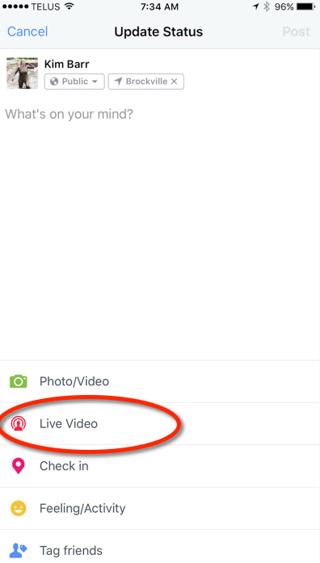
Mobile and Desktop

Slide 42
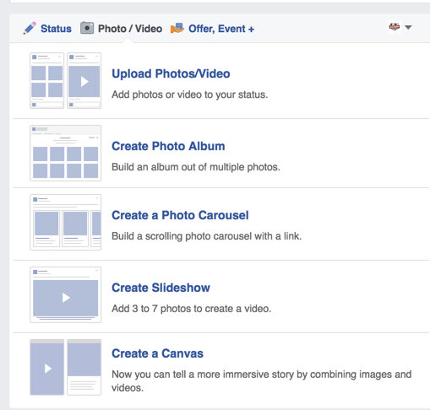
Photo / Video Options

Slide 43
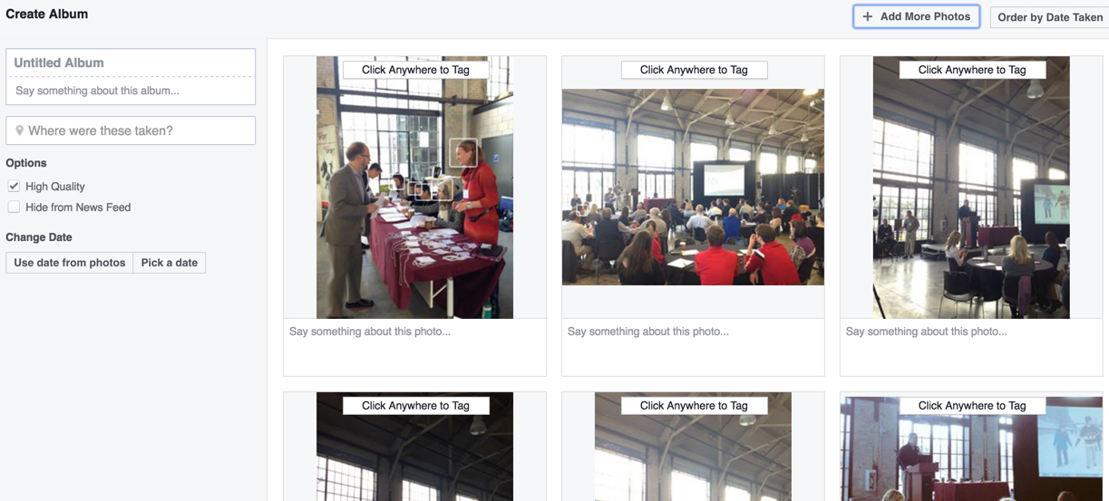
Creating an Album

Slide 44
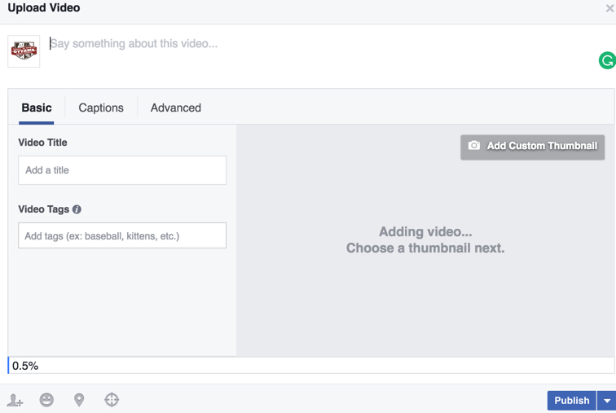
Video Upload

Slide 45
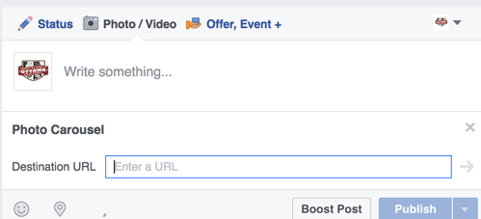
Photo Carousel

Slide 46
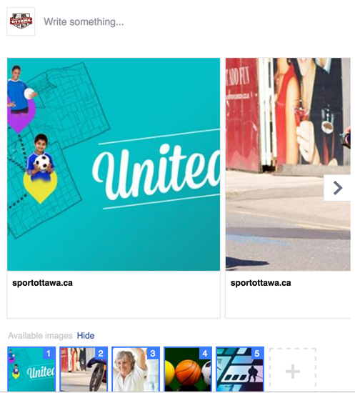
Photo Carousel Cont…

Slide 47
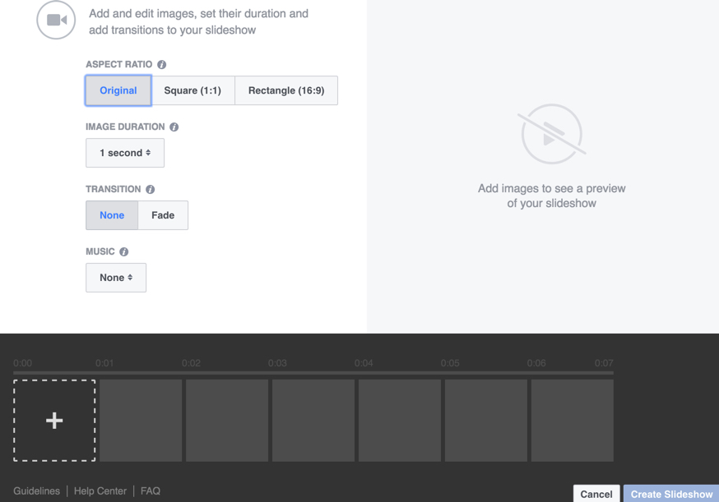
Creating a Slideshow

Slide 48
Creating a Canvas
This option is for combining with images and videos.
Tip: always start with a image.
Tip: Keep in mind before starting that it's a best practice to have thought through what sort of experience you want to create for people, and to have your creative assets ready ahead of time.

Slide 49
Get in touch
Marcia Morris
Executive Director
Ottawa Sport Council
marci@sportottawa.ca
sportottawa.ca
Kim Barr
Proprietor
Set The Barr
kim@setthebarr.com
settthebarr.com
Amanda Burford
Club Excellence
aburford@cces.ca
clubexcellence.com

Slide 50
Thank You
This concludes the Volunteer Management: Standards, Good Practices & Practical Solutions module, continue learning by watching the other modules in this series:
Governance: Building Your Best Board
Volunteer Management: Standards, Good Practices &
Practical Solutions

