Slide 1


Slide 2
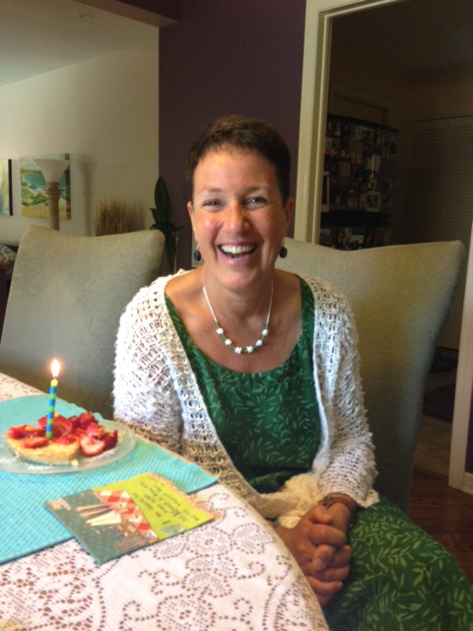
Ottawa Sport Council
Non-profit membership based service organization established in response to demand for assistance from community sporting organizations
Marcia Morris
ED, Ottawa Sport Council
What do we Do?
  Advocacy and Marketing
  Educational Programs- webinars, Sport Summit
  Ottawa Sport Council Foundation- endowment fund to support community sport organizations

Slide 3

Ottawa Sport Council Community
Sport Education
2015- 8 educational overview webinars including legal issues, event management, nutrition, sponsorship, Twitter, governance, volunteers
Feedback
  requirement for more comprehensive education - accessible, on-demand format.
  Education regarding sport management topics - social media marketing, governance, volunteer management.
Deliverable
  development of comprehensive on-line modules
  courses developed to help community sport organizations to understand ‘Club Excellence’ standards - the only national multi-sport certification program for club level sport organizations (www.clubexcellence.com)
  Courses – delivered in segments, available on demand
Thanks to Ontario Trillium Foundation

Slide 4

Today’s Speaker
Dina Bell-Laroche
Partner
Sport Law & Strategy Group
dbl@sportlaw.ca
sportlaw.ca

Slide 5
Segment 1 of 4

Slide 6

What you will learn from this Module
Enhanced understanding of how to retain your volunteers through proactive management strategies
Increased motivation to apply what you learn during the Module
Increased connection with your peers
Focused on Board volunteers but many points are relevant to how we manage all volunteers
Notes:
CE standards – base vs best practices

Slide 7

What this Module covers
Having the right policies in place
Defining roles and responsibilities
Board accountability
Recruitment and orientation strategies
Monitoring and evaluating performance
Volunteer appreciation

Slide 8
Volunteer Management
Helps you understand the Club Excellence standards
related to:
People policies
Roles and responsibilities
Accountability
Recruitment and orientation
Performance management

Slide 9
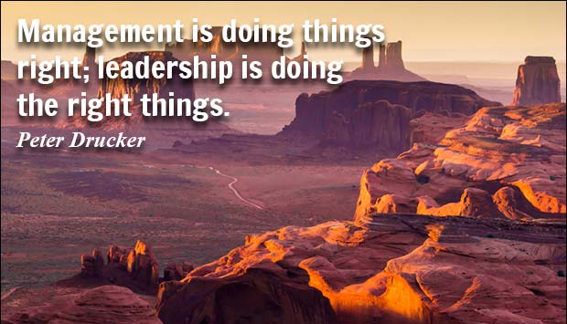
Policies

Slide 10
It starts with good policies
Keep in mind the importance of meeting minimum legal requirements (e.g. Occupational Health Safety Act; Accessibility for Ontarians with a Disability Act; etc.), Employment Standards Act and established practices (e.g. two-deep rule)
Identify the most important Human Resource Policies you need
Prioritize the most important ones
Have the Board approve the policies and keep track of when they were last reviewed
Create an implementation plan to bring your policies to life
Monitor your Club’s adherence to each policy (ideally on a yearly basis)
Notes:
I will give lots of examples here
Code of Conduct
Discipline and Complaints Policy
Dispute Resolution Policy
Appeals Policy
Conflict of Interest Policy
Confidentiality Policy
Social Media Policy
Risk Management Policy
Screening Policy (for coaches and volunteers)
Human Resources Policy (if paid staff)
Selection policy
Financial Policy
Transgender Policy
Equity and Access Policy
Health and Safety Policy (including Workplace Violence and Harassment) – legally required
Accessibility Policy – legally required
Privacy Policy – legally required
Legal Requirements:
Occupational Health and Safety Act (OHSA) (if at least 1 paid staff)
policy and risk assessments re: physical environment (old requirements)
policy and risk assessments re: Workplace Violence, Bullying and Harassment (new requirements)
train and display Prevention Poster in office
Accessibility for Ontarians with a Disability Act (AODA) (if at least 1 paid staff)
policy and notice requirements re: Customer Service Standards
program requirement re: Integrated Service Standards
train and display Accessibility Poster in office
Employment Standards Act (if a least 1 paid staff)
ensure contracts and agreements meet minimum legislative requirements re: overtime, vacation, statutory holidays, severance, etc.
display ESA Poster in office and provide copy to individual staff

Slide 11
Definition of policies
Framework policies: these are the written statements of the vision, values, mission of the organization
Governance policies: these are the legal documents relating to the incorporation and policies relating to organizational structure; to roles, responsibilities and duties of the board, staff, committees and volunteers; to the awarding and revoking of privileges of membership; to dispute resolution; and
Operational policies: these are the policies relating to the operational details of the programs, personnel, finance, and communications
Notes:
I will give lots of examples here
Code of Conduct
Discipline and Complaints Policy
Dispute Resolution Policy
Appeals Policy
Conflict of Interest Policy
Confidentiality Policy
Social Media Policy
Risk Management Policy
Screening Policy (for coaches and volunteers)
Human Resources Policy (if paid staff)
Selection policy
Financial Policy
Transgender Policy
Equity and Access Policy
Health and Safety Policy (including Workplace Violence and Harassment) – legally required
Accessibility Policy – legally required
Privacy Policy – legally required
Legal Requirements:
Occupational Health and Safety Act (OHSA) (if at least 1 paid staff)
policy and risk assessments re: physical environment (old requirements)
policy and risk assessments re: Workplace Violence, Bullying and Harassment (new requirements)
train and display Prevention Poster in office
Accessibility for Ontarians with a Disability Act (AODA) (if at least 1 paid staff)
policy and notice requirements re: Customer Service Standards
program requirement re: Integrated Service Standards
train and display Accessibility Poster in office
Employment Standards Act (if a least 1 paid staff)
ensure contracts and agreements meet minimum legislative requirements re: overtime, vacation, statutory holidays, severance, etc.
display ESA Poster in office and provide copy to individual staff

Slide 12
Framework policies
Your mission states your reason for being by clearly expressing your organization’s purpose in a way that inspires support and ongoing commitment
Your vision is a snapshot of your preferred future. It’s a bold, inspirational statement that can help you prioritize and motivate people to work towards a common goal.
Your values are a statement of what matters most to you as an organization; Agreed to principles or beliefs that are shared among key stakeholders of an organization.
Notes:
Check out the Ottawa Sport Council website. www.Sportottawa.ca in About Us and By-laws and Policies
Legal Requirements:
Occupational Health and Safety Act (OHSA) (if at least 1 paid staff)
policy and risk assessments re: physical environment (old requirements)
policy and risk assessments re: Workplace Violence, Bullying and Harassment (new requirements)
train and display Prevention Poster in office
Accessibility for Ontarians with a Disability Act (AODA) (if at least 1 paid staff)
policy and notice requirements re: Customer Service Standards
program requirement re: Integrated Service Standards
train and display Accessibility Poster in office
Employment Standards Act (if a least 1 paid staff)
ensure contracts and agreements meet minimum legislative requirements re: overtime, vacation, statutory holidays, severance, etc.
display ESA Poster in office and provide copy to individual staff

Slide 13
Governing Policies
Code of Conduct
Conflict of Interest Policy
Confidentiality Policy
Risk Management Policy
Health and Safety Policy (including Workplace Violence and Harassment) – legally required
Accessibility Policy – legally required
Privacy Policy – legally required
Discipline and Complaints Policy
Dispute Resolution Policy
Appeals Policy
Selection policy
Screening Policy (for coaches and volunteers)
Notes:
Check out the Ottawa Sport Council website. www.Sportottawa.ca in About Us and By-laws and Policies
Legal Requirements:
Occupational Health and Safety Act (OHSA) (if at least 1 paid staff)
policy and risk assessments re: physical environment (old requirements)
policy and risk assessments re: Workplace Violence, Bullying and Harassment (new requirements)
train and display Prevention Poster in office
Accessibility for Ontarians with a Disability Act (AODA) (if at least 1 paid staff)
policy and notice requirements re: Customer Service Standards
program requirement re: Integrated Service Standards
train and display Accessibility Poster in office
Employment Standards Act (if a least 1 paid staff)
ensure contracts and agreements meet minimum legislative requirements re: overtime, vacation, statutory holidays, severance, etc.
display ESA Poster in office and provide copy to individual staff

Slide 14
Operational Policies
Social Media Policy
Human Resources Policy (if paid staff)
Transgender Policy
Equity and Access Policy
Concussion policy
Financial Policy
Sample Policies & Bylaws
Ottawa Sport Council - http://sportottawa.ca/about-us/our-bylaws/ and www.sportlaw.ca
Notes:
Check out the Ottawa Sport Council website. www.Sportottawa.ca in About Us and By-laws and Policies
Legal Requirements:
Occupational Health and Safety Act (OHSA) (if at least 1 paid staff)
policy and risk assessments re: physical environment (old requirements)
policy and risk assessments re: Workplace Violence, Bullying and Harassment (new requirements)
train and display Prevention Poster in office
Accessibility for Ontarians with a Disability Act (AODA) (if at least 1 paid staff)
policy and notice requirements re: Customer Service Standards
program requirement re: Integrated Service Standards
train and display Accessibility Poster in office
Employment Standards Act (if a least 1 paid staff)
ensure contracts and agreements meet minimum legislative requirements re: overtime, vacation, statutory holidays, severance, etc.
display ESA Poster in office and provide copy to individual staff

Slide 15

Thank You
This concludes Segment 1 of Volunteer Management: Standards, Good Practices & Practical Solutions, continue learning by watching:
Segment 2 on Roles & Responsibilities and Accountability
Segment 3 on Recruitment and Orientation
Segment 4 on Performance Management

Slide 16
Segment 2 of 4

Slide 17

Roles & Responsibilities

Slide 18
Define clearly what you want people to do
Review your needs first and then determine how volunteers can help
Write clear job descriptions that specify required skills and training, time commitment, specific credentials, reporting structure
Create a recruitment strategy that includes timelines, selection process, communications strategy
Have volunteers sign a Letter of Agreement outlining their adherence to important Club policies such as code of conduct, confidentiality, conflict of interest, etc.
Have volunteers sign a Code of Ethics

Slide 19
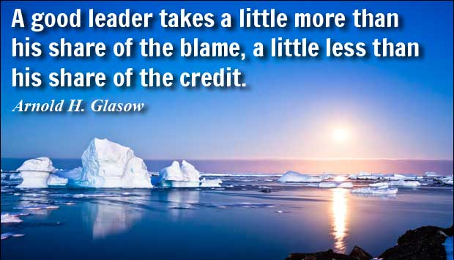
Accountability

Slide 20
Clarity of roles
Clarity of who is responsible for what … stated simply, the Board is responsible for oversight, risk management, planning, and hiring the senior most staff person.
The Board hires, terminates and evaluates the performance of the senior most staff person.
For organizations who have no staff, it is still important to separate the duties of the Board from the duties of the volunteers who are managing operations. Ideally, organizations avoid the same people serving in both roles.
Each Committee (both of the Board and Operations) should have Terms of Reference in place that clearly state: purpose, composition, reporting structure, decision-making, norms, timelines, etc.

Slide 21
Oversight
The senior most staff person (or designated volunteer) regularly reports to the Board – frequency is determined by the Board
Minutes are taken at every Board meeting and previous meeting minutes are reviewed and approved by the Board
The Board evaluates the performance of the senior most staff person (or designated volunteer) on a yearly basis based on agreed to milestones/ deliverables
The Board sets the course for the direction of the organization and ensures its fiduciary duty is met (legal and moral obligation)
The Board manages risks either formerly (through a risk management policy) or informally during Board meetings

Slide 22
Planning to succeed
The Board’s responsibility is to set the course for the future. The Staff or designated volunteers responsibility is to implement the strategies identified as being mission critical for success
A strategic planning process is a tool that can be used to determine relevant priorities and engage stakeholders in shaping the future of the organization. The strategic plan is the main tool the Board uses to monitor progress and to guide financial, human resources and other critical decisions
The relationship and accountability between the Board and Staff is significantly enhanced when good planning is in place

Slide 23
Thank You
This concludes Segment 2 of Volunteer Management: Standards, Good Practices & Practical Solutions, continue learning by watching:
Segment 1 on Policies
Segment 3 on Recruitment and Orientation
Segment 4 on Performance Management

Slide 24
Segment 3 of 4

Slide 25

Recruitment & Orientation

Slide 26
Map out your needs
Determine your needs – this might mean conducting an organizational review; check out what other clubs are doing and how they are structured
Do a skills matrix for your Board; avoid duplicating with the skills you already have
Strike a hiring/ recruiting committee
Connect with other organizations and borrow templates
Write good job/ volunteer descriptions … review them annually
Conduct quality interviews: ask powerful questions; get creative; look for ‘fit’ … and check references
Introduce your candidate(s) to the other Board members and Staff in a casual session. Get feedback.

Slide 27
Recruit wisely
Ensure you recruit volunteers that have the skills, knowledge, time, desire, and credibility for the assignment.
Publish job descriptions for each role; provide minimum time and training requirements; be clear about accountability.
For volunteers dealing with vulnerable populations, ensure they have a valid Police Record Check; conduct reference checks; coordinate an interview to ensure fit.
Ensure you have shared expectations of what these roles entail.

Slide 28
Retaining the ‘great’ ones
Once hired, support your new volunteer/ Staff throughout the entry process. Remember, it takes about a year to acclimatize to the new culture
Set specific milestones and ensure clarity of reporting structure
Conduct an orientation process; assign a more seasoned volunteer to mentor the new recruit; check-in to see how they are doing.
Offer up training opportunities … easier to train the great ones
Change of scenery… look to deploy in different area of the organization
Evaluate performance … feedback is key
Say thank you … recognize exemplar performance
Develop a succession plan for Board and Staff so that when they leave, the corporate memory is preserved

Slide 29
The importance of Board orientation
Share your by-laws and other key governing documents; previous minutes; strategic plan and budgets
Assign a ‘buddy’
At first meeting, have each director speak to why they volunteer and what their specific skill set is
Speak to the purpose of the Board and your overall philosophy
Ensure that the new Director understands and complies with their fiduciary responsibility, signs the organization’s Code of Ethics, the Conflict of Interest and Confidentiality policies

Slide 30
Thank You
This concludes Segment 3 of Volunteer Management: Standards, Good Practices & Practical Solutions, continue learning by watching:
Segment 1 on Policies
Segment 2 on Roles & Responsibilities and Accountability
Segment 4 on Performance Management

Slide 31
Segment 4 of 4

Slide 32
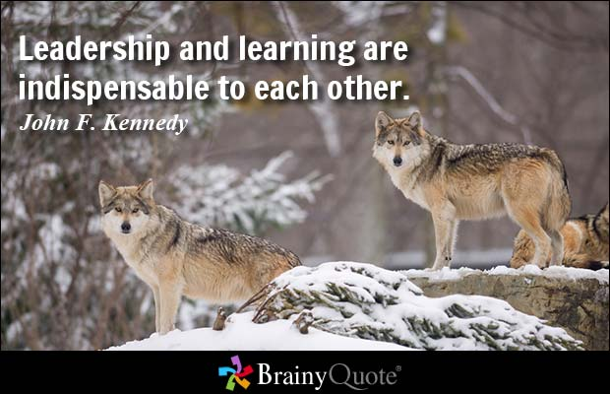
Performance Management

Slide 33
Evaluating performance
Conduct an evaluation of the senior most Staff person/ volunteer; document the process
Consider doing a 360 review of the Board’s performance; ask Staff or other volunteers for input; set new goals for the upcoming year
Adopt a learning culture for Board, Staff and Committees: Learn from what didn’t and did go well
Conduct reviews of major projects – how well did we do; what did we learn; what would we do differently next time

Slide 34
Celebrate success
Say something … people like to be recognized
Share the spotlight … acknowledge all those who contributed
Gifts of recognition … scale appropriately
Host volunteer appreciation gatherings … make it fun, informal, etc.
Encourage Staff and volunteers to also show appreciation for each other

Slide 35



Get in touch
Marcia Morris
Executive Director
Ottawa Sport Council
marci@sportottawa.ca
sportottawa.ca
Dina Bell-Laroche
Partner
Sport Law & Strategy Group
dbl@sportlaw.ca
sportlaw.ca
Amanda Burford
Club Excellence
aburford@cces.ca
clubexcellence.com

Slide 36

Thank You
This concludes the Volunteer Management: Standards, Good Practices & Practical Solutions module, continue learning by watching the other modules in this series:
Governance: Building Your Best Board
How to Facebook

Slide 37


